Slide 1


Smart Weather App
IMAD PRACTICUM presentation by: st10441362

Slide 2
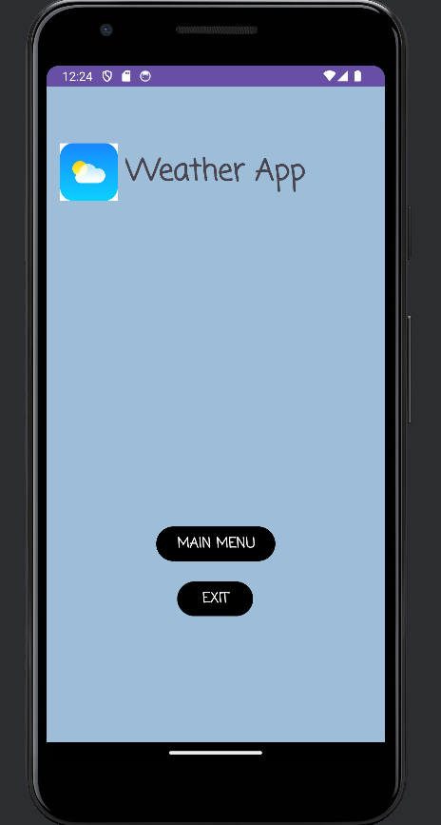
Splash Screen
Initial screen on start up of app
Includes two buttons (Main Menu and Exit)
Main Menu: Takes you the Splash Screen
Exit: Exits the app/ Closes the app

Slide 3
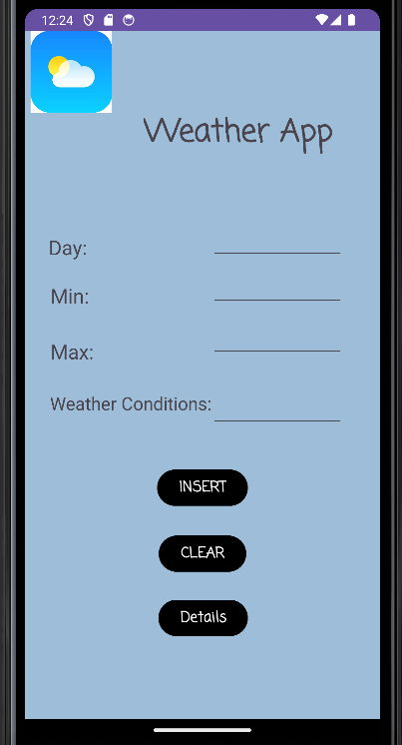
Main Screen
Includes 3 buttons (Insert, Clear, Details)
Insert: Stores the user input
Clear: Used to clear input from text views
Details: Takes us to the Detailed View Screen
Here the user is required to enter in their data for :
Day: The day of the week.
Min Degrees: The lowest temperature for the day.
Max Degrees: The highest temperature for the day
Weather Condition: Description of the weather (Partly cloudy, sunny, rainy etc.)

Slide 4
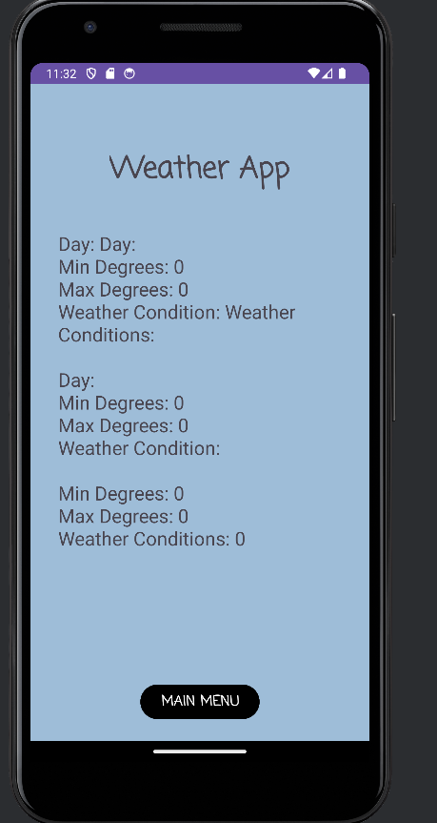
Detailed Screen View
This screen contain sone button (Main Menu)
Main Menu: Used to return to the splash screen
This screen does the following:
Displays the weekly weather conditions.
Displays the average temperature for the week.

